Slide 1

Virtual Nesting Controls for Network Revenue Management
Automation 71

Slide 2



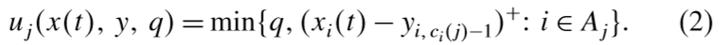
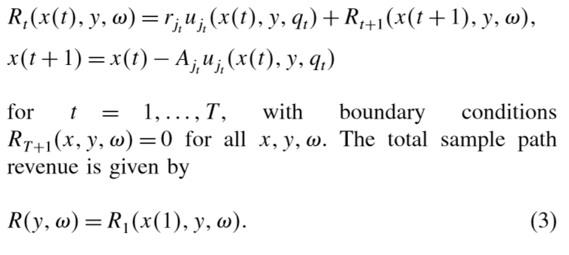
network: m resources(single-leg flight)、n products(itinerary, O-D pairs)
A sequence of customer request.
The amount of request accepted.
The remaining capacity in a single-leg flight.
Revenue.

Slide 3
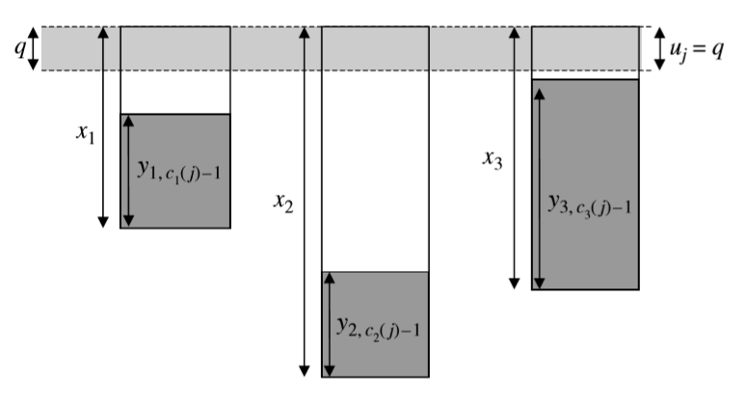
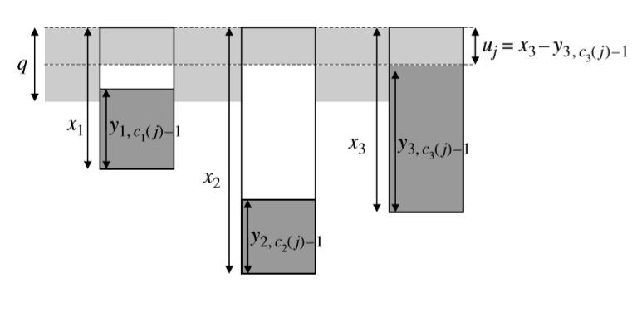
The amount of request accepted.
Accepted
Rejected

Slide 4
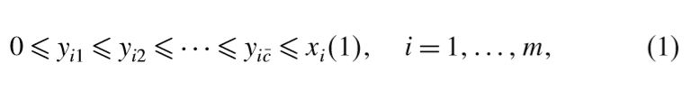
Protection Level and Virtual Nesting
class1
class2
the higher level class
class3

Slide 5
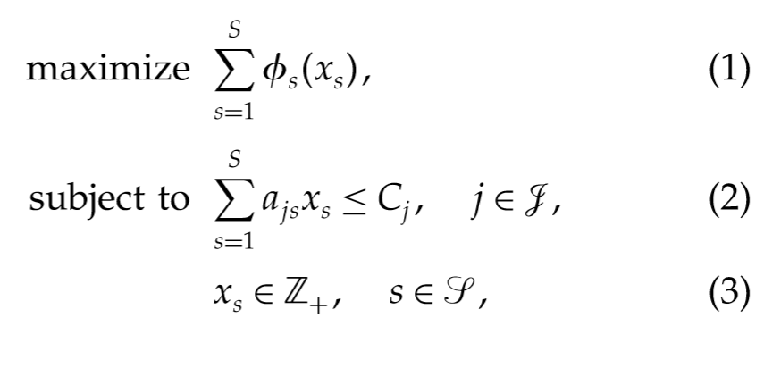
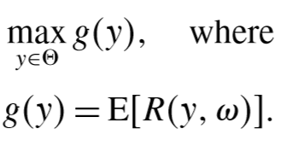
The Model
Virtual Nesting Control
OD Decomposition

Slide 6



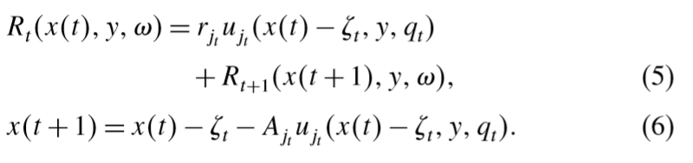
Redefine (for some function properties)

Slide 7
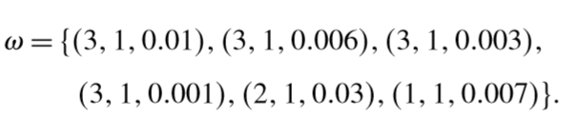



An Exemple for one single-leg flight and one itinerary
Customer | Type | q | The amount of Accepted | Decision | Remaining Capacity
1 | 3 | 1 | 8 – 4- 0.01 > 1 | Accepted | 8-0.01=6.99
2 | 3 | 1 | 6.99 – 4 -0.006 >1 | Accepted | 6.99-0.006-1=5.984
3 | 3 | 1 | 5.984 – 4 -0.003>1 | Accepted | 5.984-0.003-1=4.981
4 | 3 | 1 | 4.981 – 4 -0.001<1 | Rejected | 4.981
5 | 2 | 1 | 4.981 – 2 -0.03 > 1 | Accepted | 4.981 – 0.03-1=3.951
6 | 1 | 1 | 3.951 – 2 -0.001> 1 | Accepted | 3.951– 0.001 -1=2.95

Slide 8
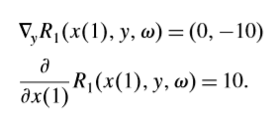
Marginal Price
Customer | Type | q | The amount of Accepted | Decision | Remaining Capacity
1 | 3 | 1 | 8 – 4- 0.01 > 1 | Accepted | 8-0.01=6.99
2 | 3 | 1 | 6.99 – 4 -0.006 >1 | Accepted | 6.99-0.006-1=5.984
3 | 3 | 1 | 5.984 – 4 -0.003>1 | Accepted | 5.984-0.003-1=4.981
4 | 3 | 1 | 4.981 – 4 -0.001<1 | Rejected | 4.981
5 | 2 | 1 | 4.981 – 2 -0.03 > 1 | Accepted | 4.981 – 0.03-1=3.951
6 | 1 | 1 | 3.951 – 2 -0.001> 1 | Accepted | 3.951– 0.001 -1=2.95

Slide 9
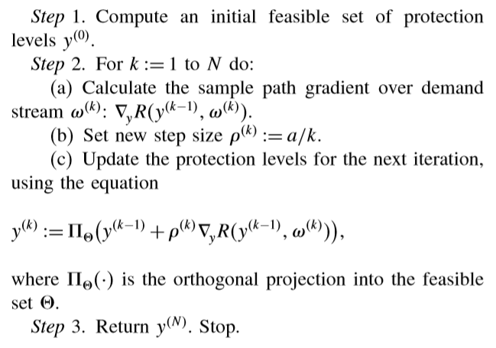

Stochastic Gradient Algorithm

Slide 10
Problem
1.In ''2.3. Example of Revenue Gradient'' ，Why ω has a random number? 2.Hwo to program to realize this model?
3.We must know all of the customers’ booking information to calculate the gradient of the revenue function with respect to y.
4. Some problems about the next step: how to get data, such as the levels, the revenue and customers’ booking information.

Slide 11
Thanks for listening!
Reference [1]Garrett van Ryzin, Gustavo Vulcano, (2008) Simulation-Based Optimization of Virtual Nesting Controls for Network Revenue Management. Operations Research 56(4):865-880. https://doi.org/10.1287/opre.1080.0550 [2]Ş. İlker Birbil, J. B. G. Frenk, Joaquim A. S. Gromicho, Shuzhong Zhang (2014) A Network Airline Revenue Management Framework Based on Decomposition by Origins and Destinations. Transportation Science 48(3):313-333. https:// doi.org/10.1287/trsc.2013.0469

